Slide 1
Deep Dive into PowerShell Universal Dashboard
Adam Driscoll
Notes:
Links:
https://www.github.com/ironmansoftware/universal-dashboard
https://github.com/brillout/awesome-react-components
https://github.com/ironmansoftware/universal-dashboard-component
https://mui.com/material-ui/customization/default-theme/
https://mui.com/material-ui/api/button/#css

Slide 2
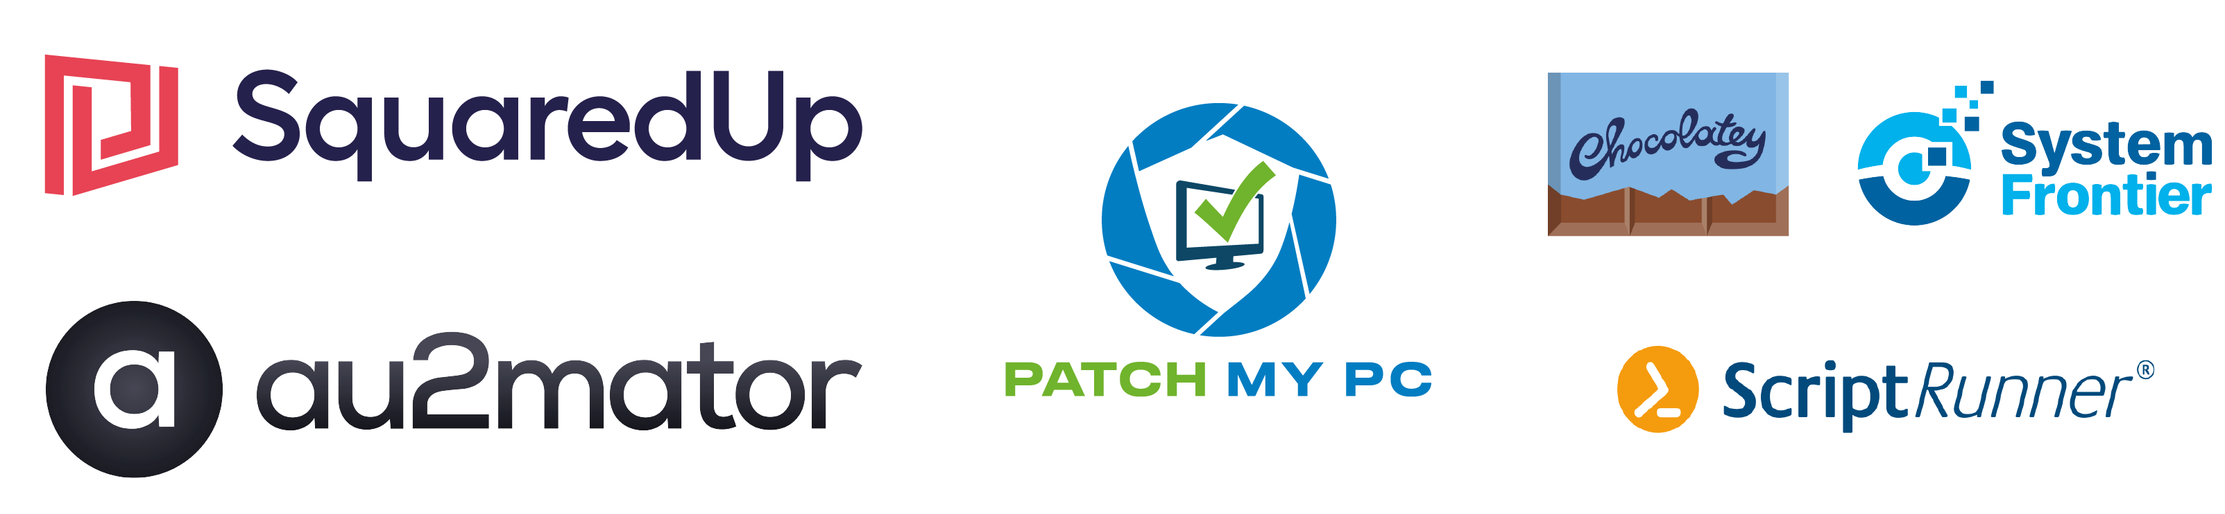
Many thanks to our sponsors:

Slide 3

Adam Driscoll
Microsoft MVP 10x
Founder of Ironman Software
PowerShell Tools for Visual Studio
PowerShell Universal
Author, YouTuber, Blogger
Cyclist, Outdoor Enthusiast

Slide 4
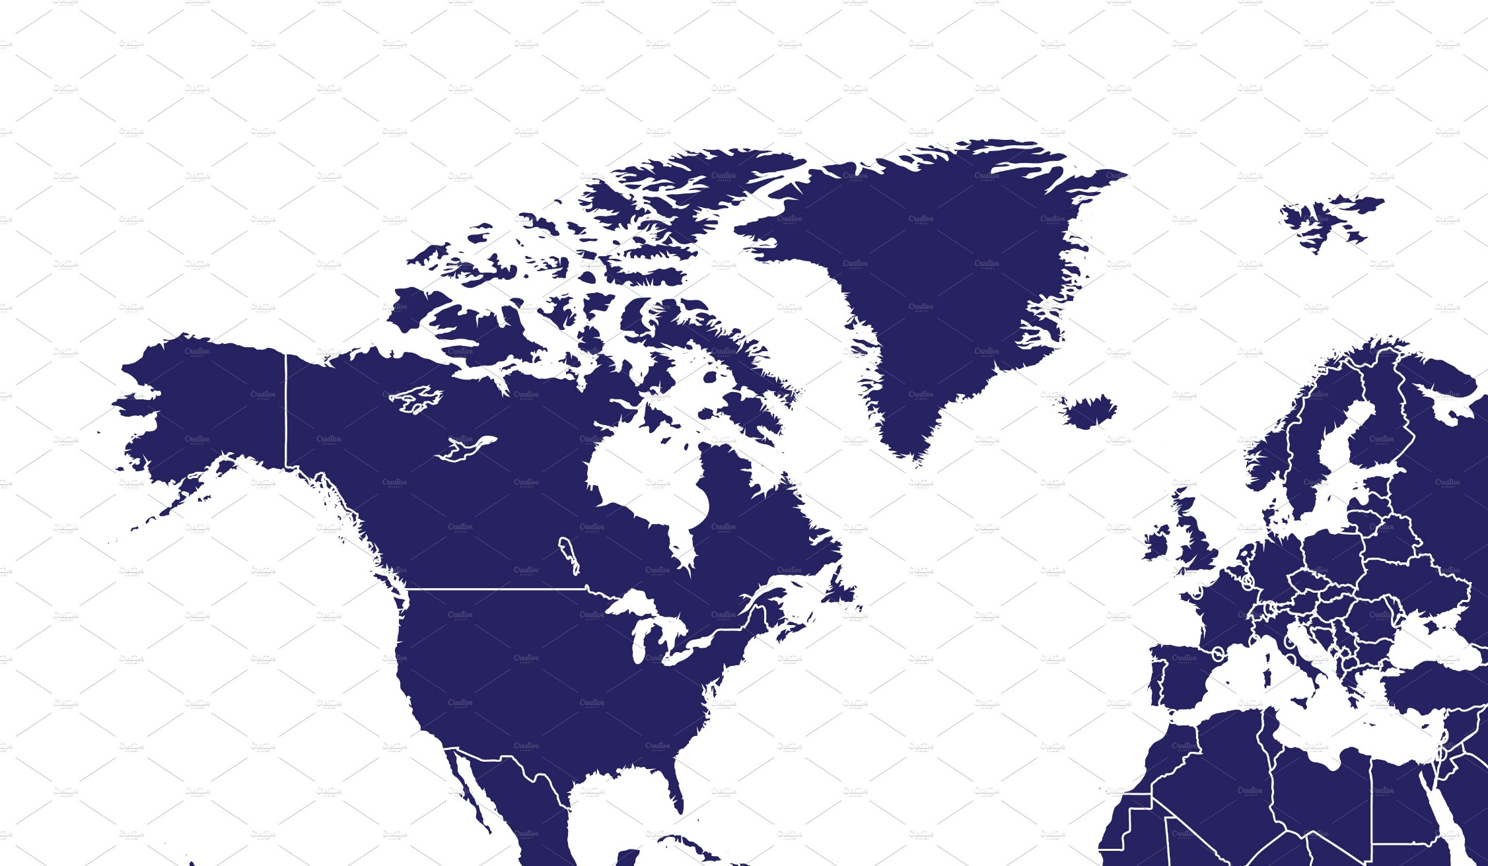
How’d I Get Here?
Hailey, ID, USA
6 hours canceled flight
2.5 hour bus ride
Boise, ID, USA
Overnight stay
2.5 hour flight
Los Angeles, CA, USA
8 hour layover
Missed flight
9 hour flight
London, UK
8 hour layover
2 hour flight
Vienna, AU
Total Travel Time: 53 hours

Slide 5
PowerShell Universal Dashboard
Misnomer from the beginning.
- Adam Driscoll

Slide 6
History
2017 – First Version of UD Released
2018 – v2 Released based on React
2019 – Rapid Explosion in Use and Community Adoption
2020 – UD becomes PowerShell Universal
2021 – PowerShell Universal v2 Released
2022 – PowerShell Universal v3 Released

Slide 7








PowerShell Universal
What is PowerShell Universal?
APIS
AUTOMATION
USER INTERFACES
ENVIRONMENTS
Create RESTful APIs that execute PowerShell scripts from anywhere.
Run and schedule scripts, listen to events and run in-browser terminals. with tight integration with the PowerShell host.
Build highly interactive user interfaces with PowerShell scripts.
Take advantage of multiple PowerShell environments with different modules, variables and credentials.
CODE-FIRST CONFIGURATION
SECURITY
PERSISTENCE
COMMUNITY
Entirely configured with PowerShell script, you can commit to source control and deploy with a CI pipeline.
Highly customizable authentication and authorization for the entire platform.
Single-file or SQL persistence of jobs, auth tokens, users and more.
Enthusiastic community of users providing help, examples and extensions.

Slide 8





PowerShell Universal Dashboard
PowerShell
Modern UI Libraries
Interactive
Develop dashboards using PowerShell scripts and call any cmdlet.
Built on MUI, Ant Design and React
Highly interactive through the use of web sockets
Extensible
Integration
Styling
Extend PowerShell Universal Dashboard with custom components
Integrate with the rest of the PowerShell Universal platform.
Highly adjustable theming components and CSS integration.

Slide 9
Agenda
Components
Pages
Theming
Interactivity
Platform Integration
Debugging
Custom Components
The Future? 🤔

Slide 10
Demo

Slide 11
Q&A
https://ironmansoftware.com/psconfeu

